Slide 1
REFERENCING & REPORTING
Computing – Faculty of Business, Law and Digital Technologies
martin.reid@solent.ac.uk

Slide 2
REFERENCING & REPORTING
STUDY SKILLS
Martin Reid – martin.reid@solent.ac.uk

Slide 3
The idiots guide to Citation, Referencing & Report Writing

Slide 4
Students
X
The idiots guide to Citation, Referencing & Report Writing

Slide 5
Research
Notes:
Before you can reference you will need to research

Slide 6
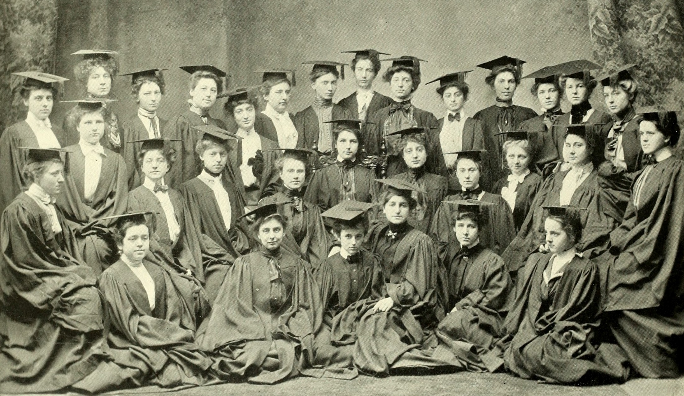
"Image from page 111 of "Mortarboard" (1901)" flickr photo by Internet Archive Book Images https://flickr.com/photos/internetarchivebookimages/14596812858 shared with no copyright restriction (Flickr Commons)
Notes:
Why do we need to reference first it is academic integrity

Slide 7
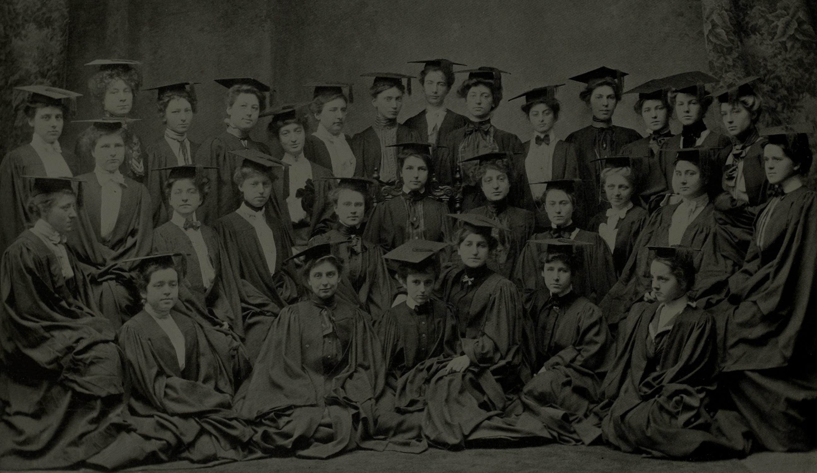
Academic Integrity
Notes:
Why do we need to reference first it is academic integrity

Slide 8

Notes:
And avoid passing off other peoples work as your own as this would be described as plagiarism

Slide 9
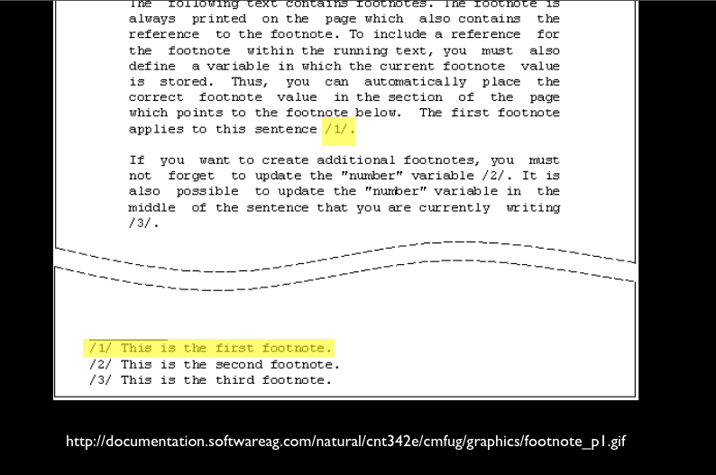
Notes:
There are a number of types of referencing systems such as footnote system

Slide 10
The in-text citation:
(Airey 2010)
Corresponding reference list item:
AIREY, D., 2010. Logo Design Love: A guide to Creating Iconic Brand Identities. Berkeley CA: New Riders.
Notes:
Example of Author date system
Author details (surname first) – use a corporate author/organisation if no individual is named
Year the material was published/created
Title details
Publication details – where and by whom a document was published (not always given for electronic material)

Slide 11

SU Harvard Reference System
Notes:
Here at Solent we use the author date Harvard referencing system

Slide 12
(Airey 2010 p.10)
Notes:
InTEXT reference: second name date and page number in brackets

Slide 13
(Airey 2010 p.10)

Slide 14
(Airey 2010 p.10)

Slide 15
(Airey 2010)

Slide 16
Airey, D., 2010 Logo Design
Love: A guide to Creating Iconic Brand Identities.
Berkeley CA: New Riders.
Notes:
The corresponding reference list item

Slide 17
Reference List
ALL sources used in the Report or Essay
Notes:
Reference list contains all the sources you have reference

Slide 18
Bibliography List
Sources used within research, but not directly referenced to.
Notes:
Reference list contains all the sources you have reference

Slide 19
In-text reference for a book with one author
(Stevens 1996)
Reference list item:
STEVENS, M., 1996 Presentation Skills.
London: Kogan Page

Slide 20
In-text reference for a book two authors:
(Stevens and Hatcher 1996)
Reference list item:
STEVENS, M. and C. HATCHER 1996 Presentation Skills. London: Kogan Page

Slide 21
In-text reference for a book with three author:
(Stevens, Smith and Hatcher 1996)
Reference list item:
STEVENS, M., A. SMITH and C. HATHER 1996 Presentation Skills. London: Kogan Page

Slide 22
In-text reference for a book three plus authors:
(Stevens et la 1996)
Reference list item:
STEVENS, M. et la 1996 Presentation Skills. London: Kogan Page

Slide 23
Secondary Sources
Shuell (cited in Biggs and Tang 2011, p.97)
Or
(Shuell cited in Biggs and Tang 2011, p.97)

Slide 24
Website:
(Stevens 1996)
Reference list item:
STEVENS, N., 1996. Presentation Skills [viewed 12 May 2016] Available from http://stevens.com/presentation-skills

Slide 25
Example of a journal entry:
KRUGER, JUSTIN & DUNNING, DAVID, 1999. Unskilled and Unaware of It: How Difficulties in Recognizing One's Own Incompetence Lead to Inflated Self-Assessments. (Statistical Data Included). Journal of Personality and Social Psychology, 77(6), pp.1121–34.
It is a good idea to add (manually) the Digital Object Identifier: DOI to the bottom of the journal reference like this:
KRUGER, JUSTIN & DUNNING, DAVID, 1999. Unskilled and Unaware of It: How Difficulties in Recognizing One's Own Incompetence Lead to Inflated Self-Assessments. (Statistical Data Included). Journal of Personality and Social Psychology, 77(6), pp.1121–34.
http://dx.doi.org/10.1037/0022-3514.77.6.1121

Slide 26
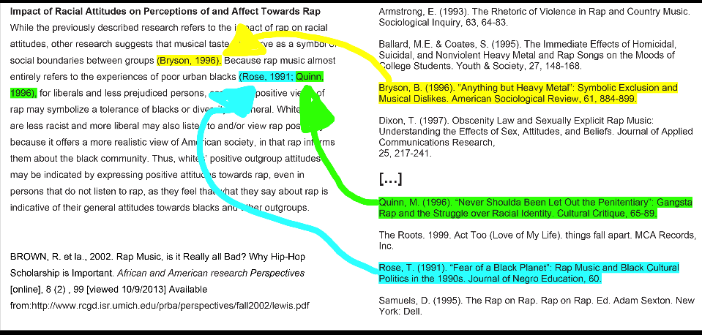
Notes:
Here is an example of InTEXT reference and and their corresponding reference list items. NOTE: Althought this example is Harvard referencing it does not use the exact same style of formatting we use here at Solent

Slide 27
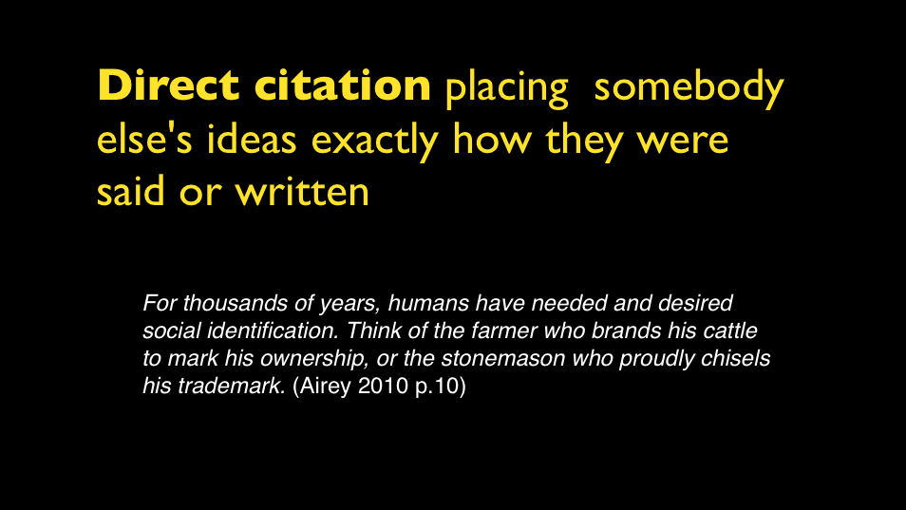

Slide 28
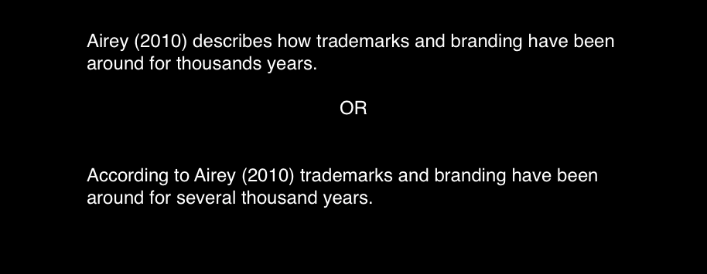

Slide 29
(Airey 2010a)
(Airey 2010b)
(Airey 2010c)
Notes:
If you have the same author but reference a number of their books add a, b, c etc

Slide 30
(Anon n.d)
Anonymous (author) and No Date (unknown date)

Slide 31
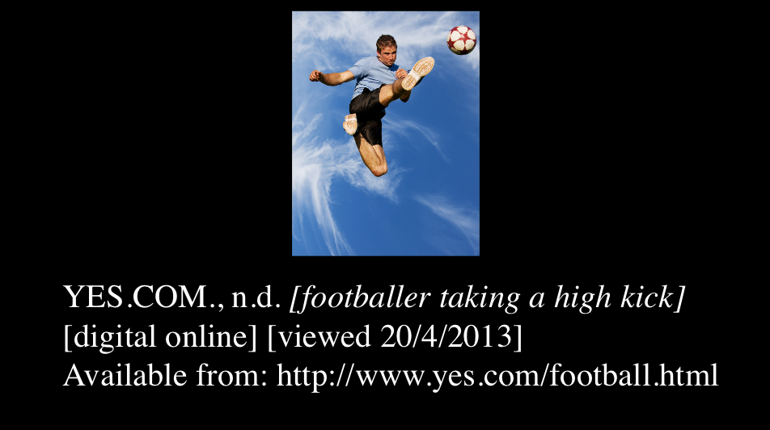
Notes:
If you have an image but do not have author or title describe the image and use the website as the author/ originator

Slide 32
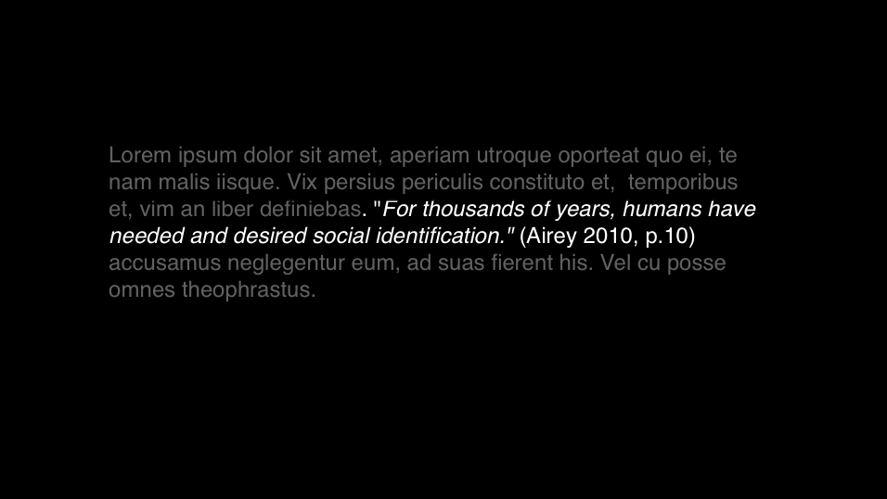
Notes:
Place short citations within the body of text

Slide 33
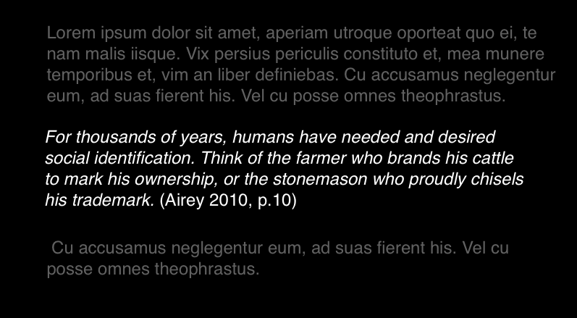
Notes:
Longer quotations as separate paragraphs make sure these are single line spacing you could place these in italics

Slide 34
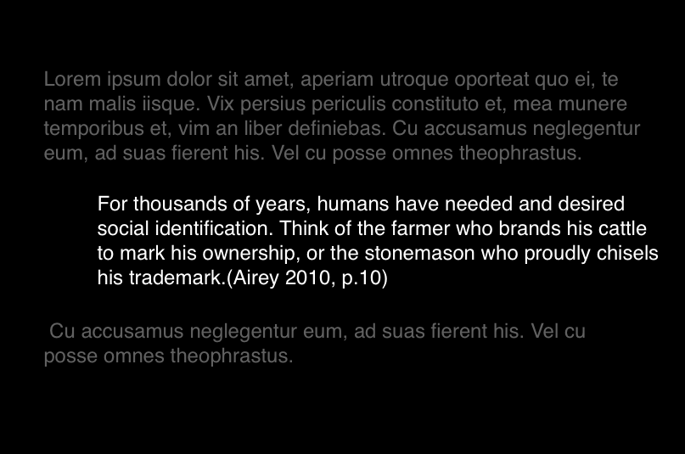
Notes:
Or you can indent

Slide 35
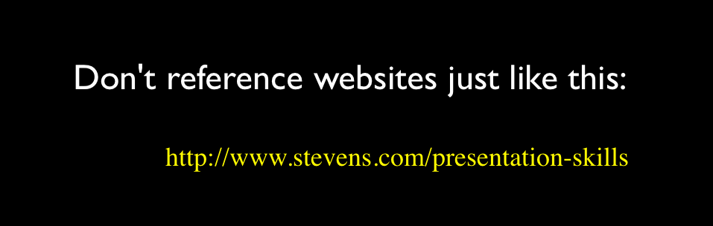
What to avoid

Slide 36
Useful abbreviations
Anon. anonymous
ed(s). editor(s) or edition
et al. and others (multiple authors)
n.d. date unknown
p. page
pp. pages
ibid. in the same book or article
op. cit. in the work already quoted

Slide 37
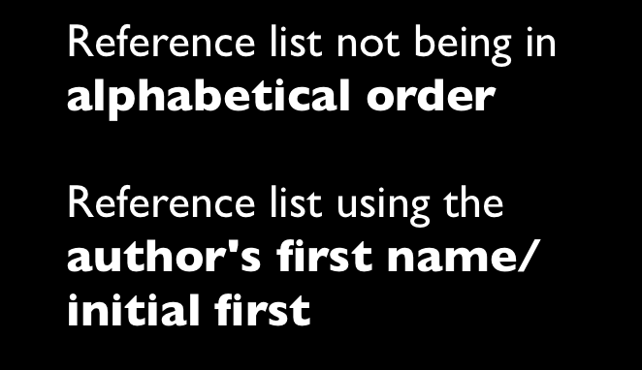
Common Mistakes

Slide 38

Notes:
But it can make

Slide 39

Notes:
or break an assignment

Slide 40
Academic Writing

Slide 41

Be objective in your thinking & writing

Slide 42
“Comic Sans is the best font in the world”
(Uncool 2013 p.50)
Notes:
Look at some ideas

Slide 43
“Comic Sans sucks”
(Cool 1998 p.51)
Notes:
Then look at other ideas they might challenge or conflict. - Balance the pros & cons

Slide 44

Notes:
Words to use when presenting other peoples ideas

Slide 45
Suggests…
Argues…
States…
Believes…
Concludes…
Proposes…
Expresses….
Holds the view that…
Draws attention to…
Describes…
Describes how…
Refers to…
Draws attention to…
Describes…
Describes how…
Refers to…
Takes the stand that…
Emphasises…
Stresses…
There is a view…
There is a theory…
There is an argument…
There is an idea…

Slide 46

Counter
-arguments
Notes:
Words to use to set out counterarguments

Slide 47
…Conflicts…
…Contrasts…
… Not accepted by…
..has been challenged by…
…on the other hand
however…
…an alternative view is…
…suggest the opposite…
…conflicting view is expressed by…

Slide 48
This conflicts with the view of Smith (2010) that…
Notes:
This is how it could look in the flow of your report,

Slide 49
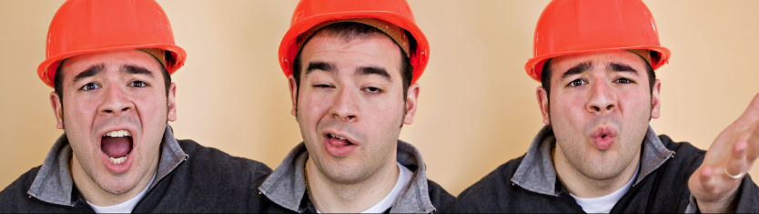
I said this…
I said that…
I think my project is really good…
Notes:
Avoid using “I”

Slide 50
When writing a academic
Report/Essay avoid using “I”
(Talking about yourself in first person)
The are exceptions, such as when writing about personal reflection and development

Slide 51
The research… The design… The project… The approach…

Slide 52



Slide 53
PLAGIARISM

Slide 54

images: Rugby471 CC BY-SA 3.0

Slide 55
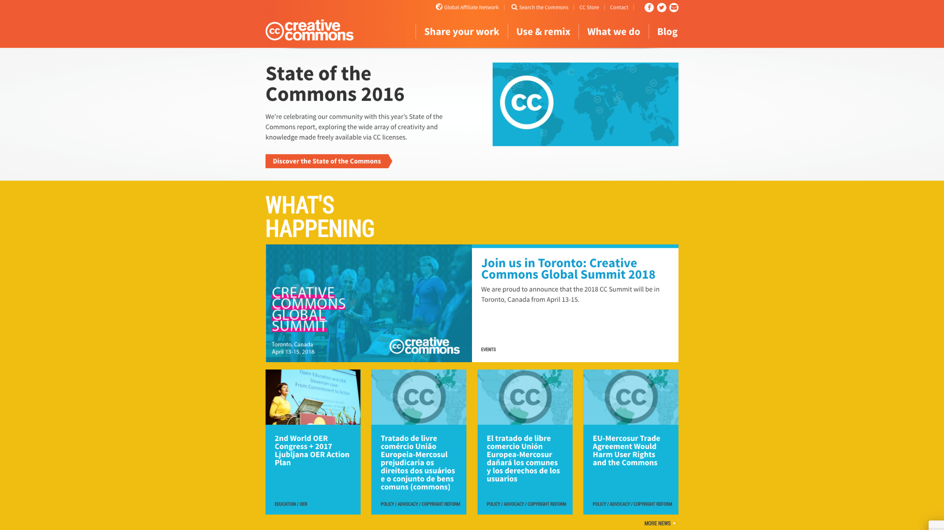
CREATIVECOMMONS. 2017. When we share, everyone wins [viewed Oct 8, 2017]. Available from: https://creativecommons.org/

Slide 56
The Block Quote
Either use sparingly or avoid using at all

Slide 57
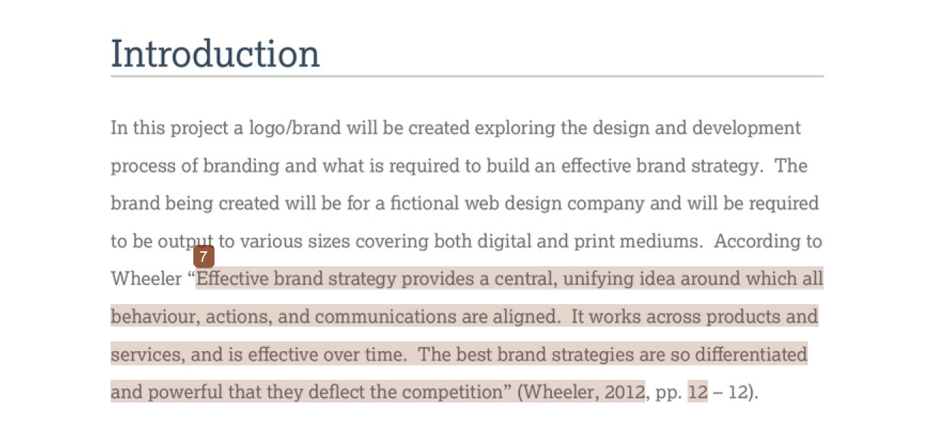

Slide 58
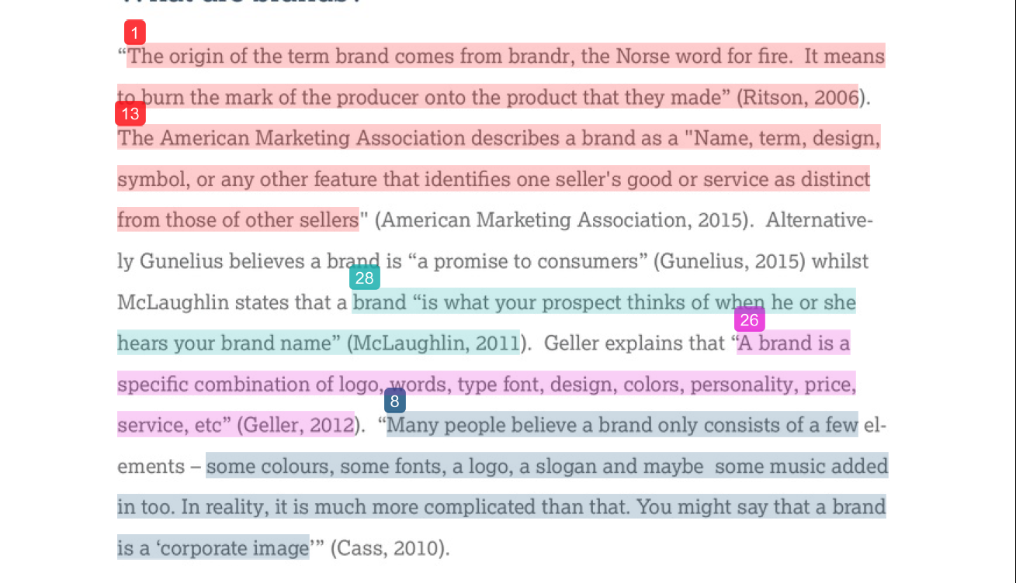

Slide 59
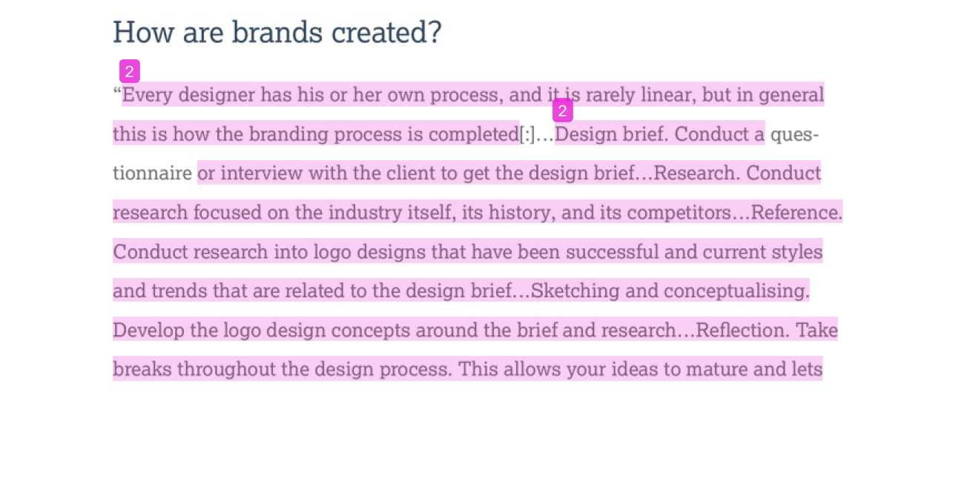

Slide 60
Paraphrasing

Slide 61
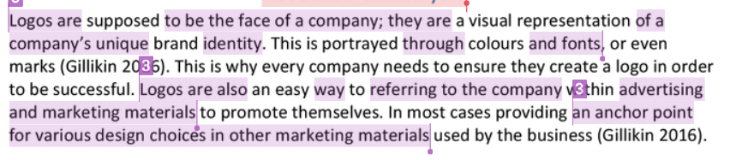
Paraphrasing is were the original work has been rearranged into a new pattern. In this example, it at first appears that the writing is all the student's “own” words, they even acknowledge the source, but there are no quotation marks.
The purple underlines show confusion between the student’s works and that of the original author.

Slide 62
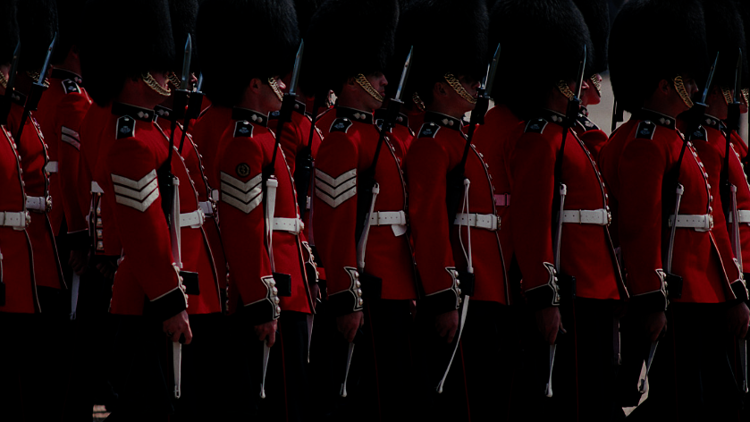
Keep your report structure uniformed
Notes:
No matter what style you may use for referencing and academic writing make sure you keep it uniformed and consistent throughout your reports

Slide 63
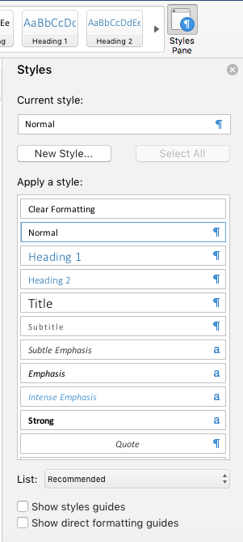
Make good use of word processing style sheets
Notes:
Make good use of word processing style sheets for titles subtitles quotes and citations and body text

Slide 64
Sign up

Slide 65

http://libguides.solent.ac.uk/refworks
Notes:
Use tools such as Refworks.com to support you

Slide 66


Slide 67
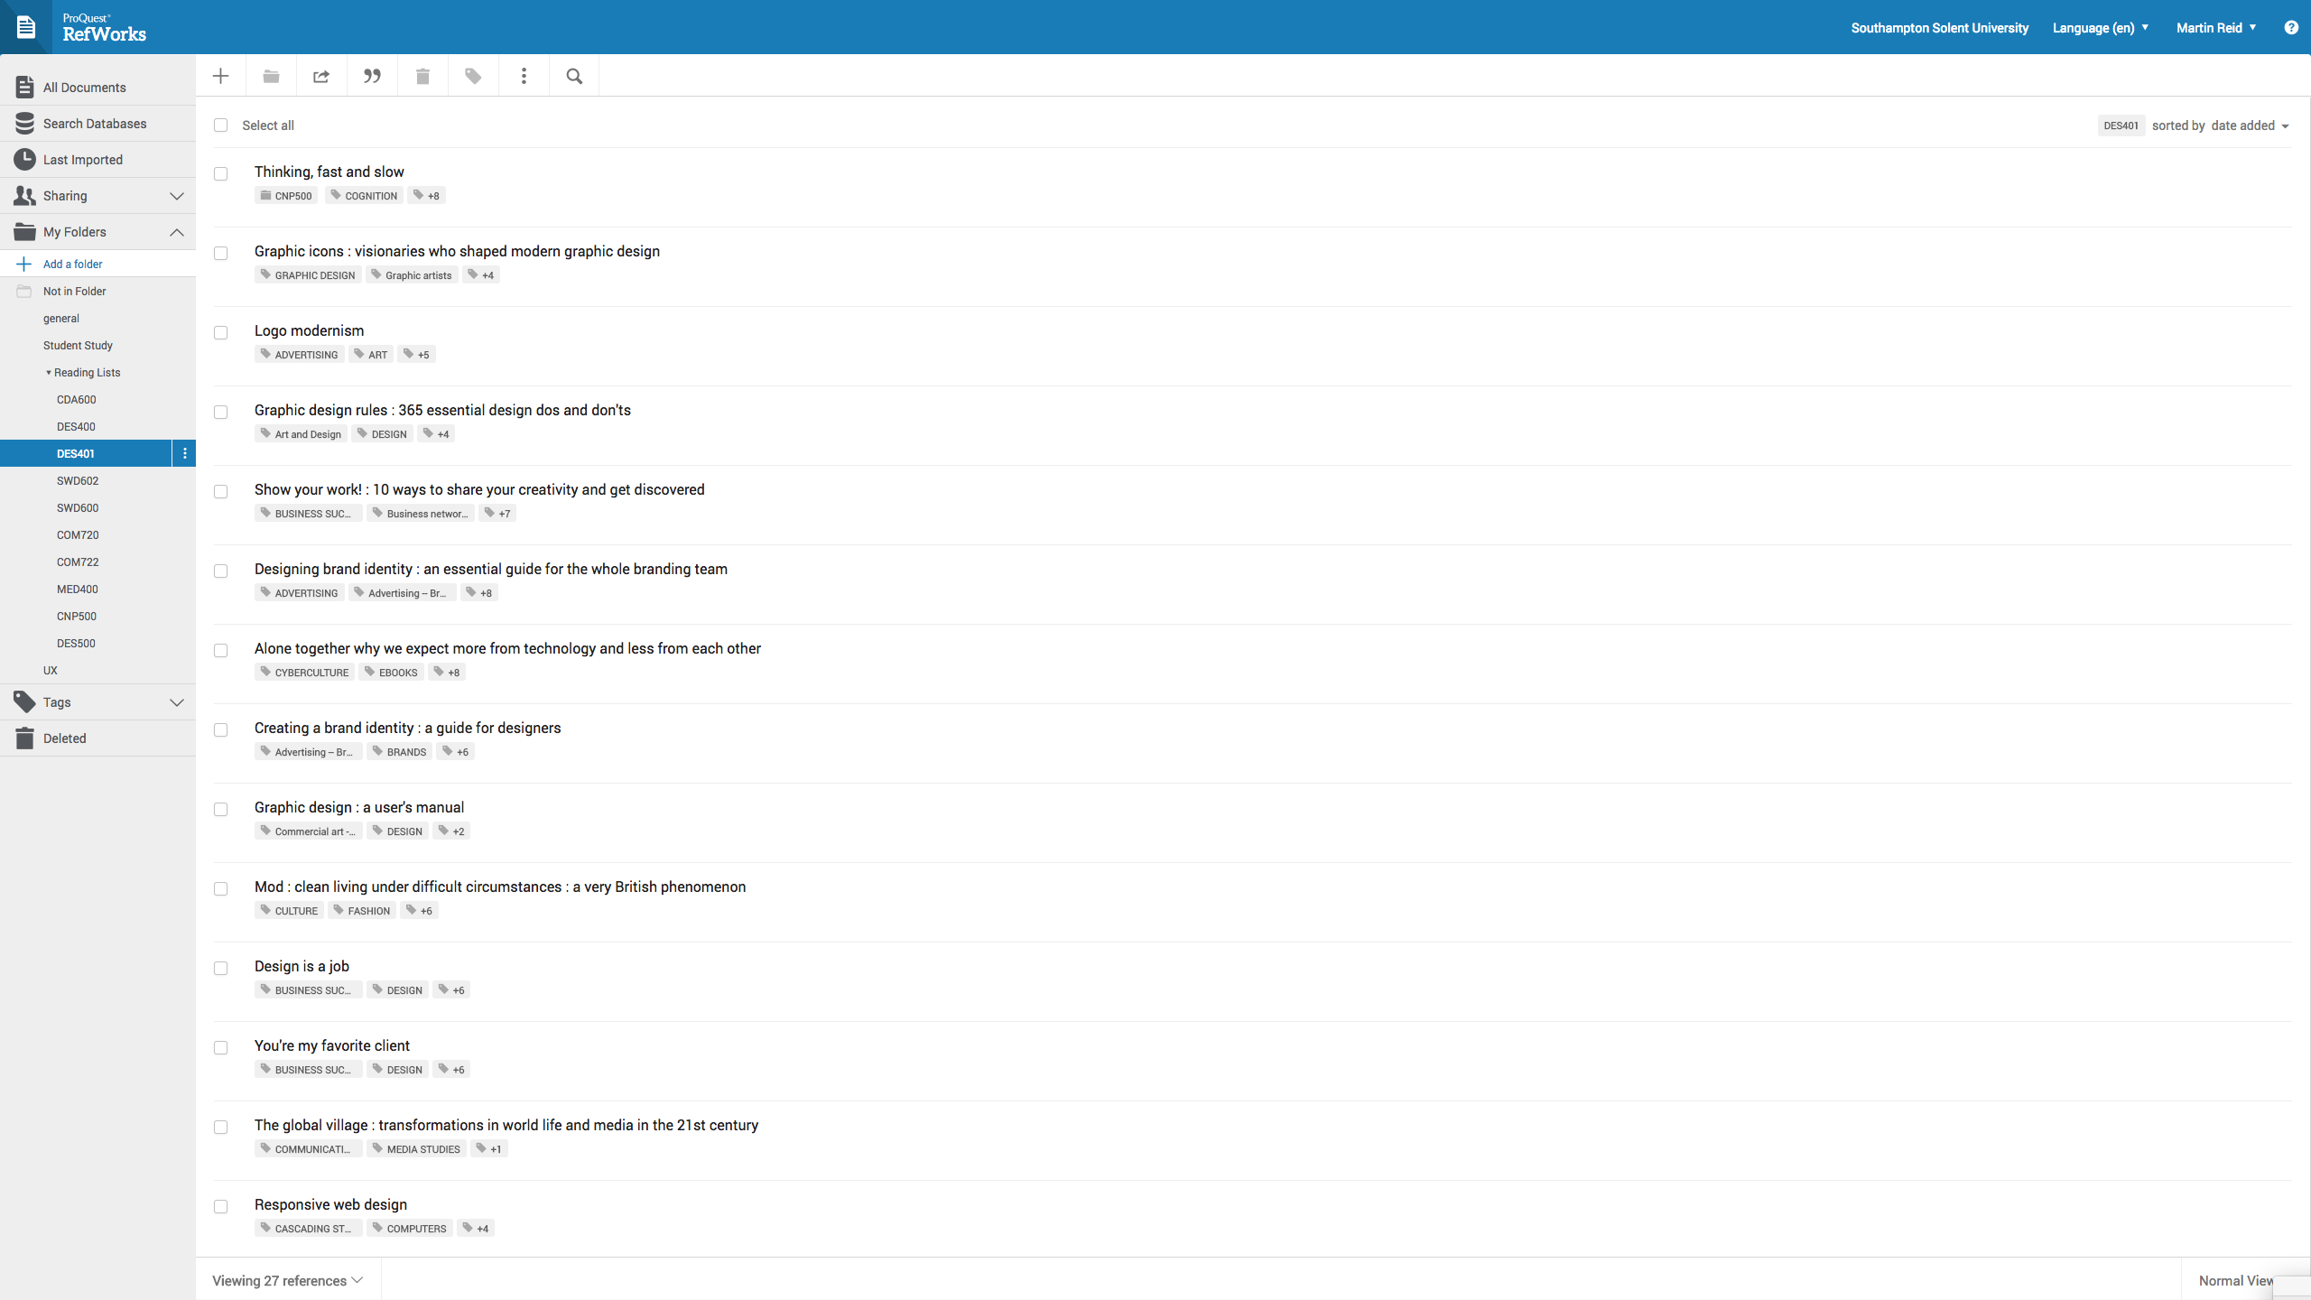

Slide 68
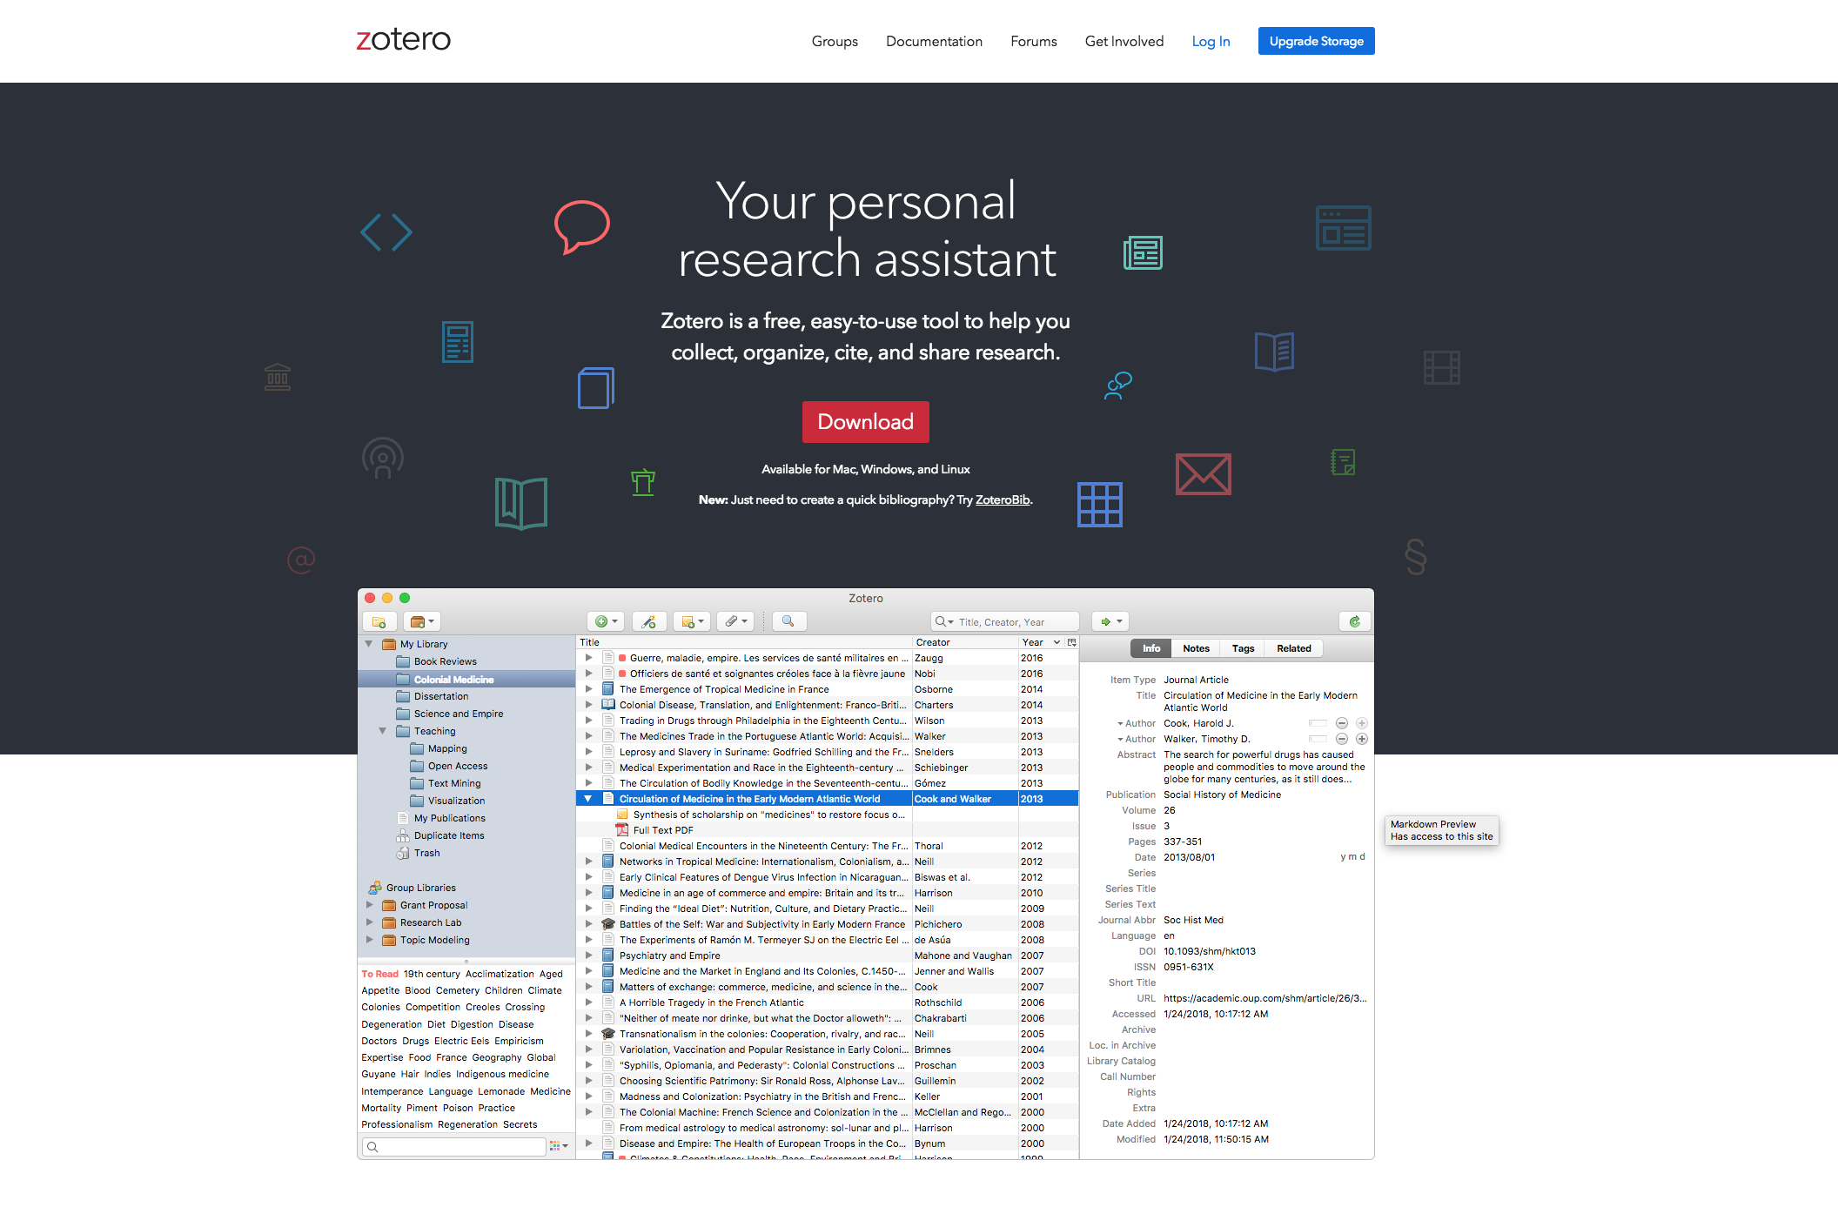
https://www.zotero.org/

Slide 69
For more detail see: Referencing: the Harvard way
Available in print from the Mountbatten Library or on the portal:
http://portal.solent.ac.uk/library/help/factsheets/resources/referencing-harvard.pdf

Slide 70
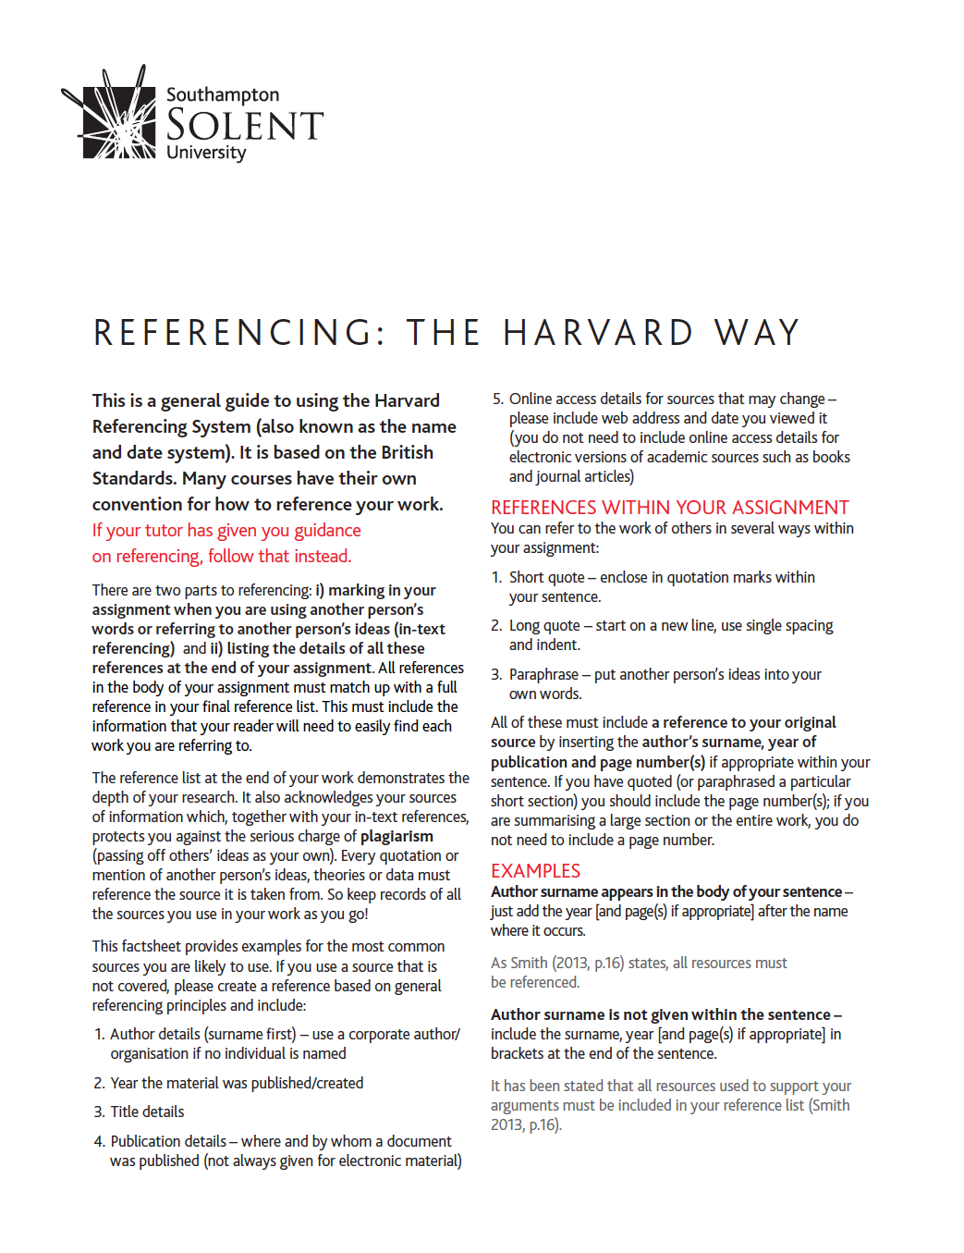

Slide 71
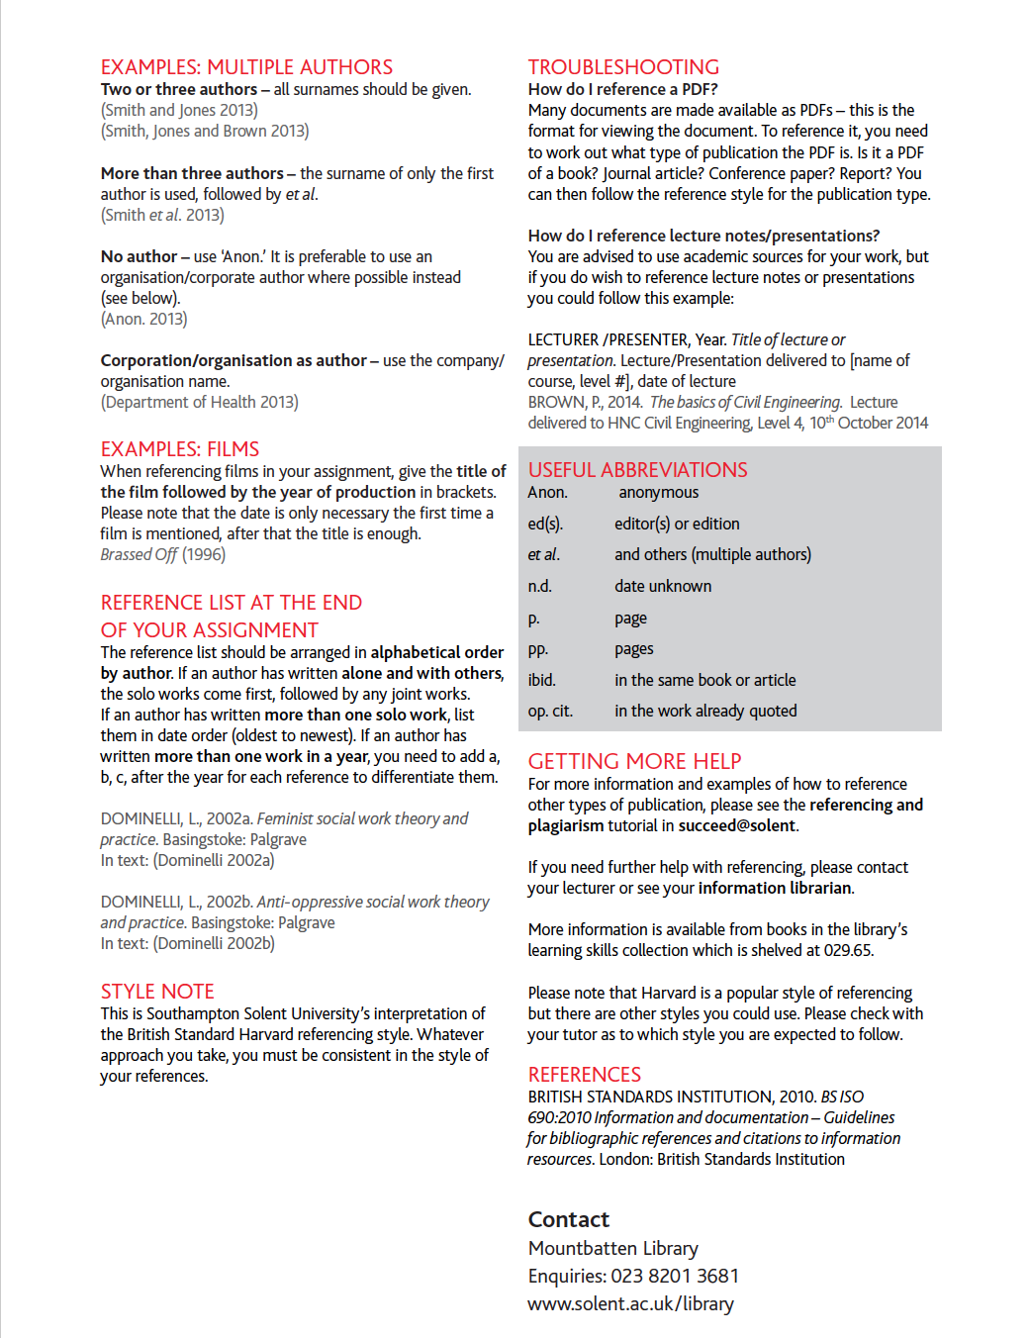

Slide 72
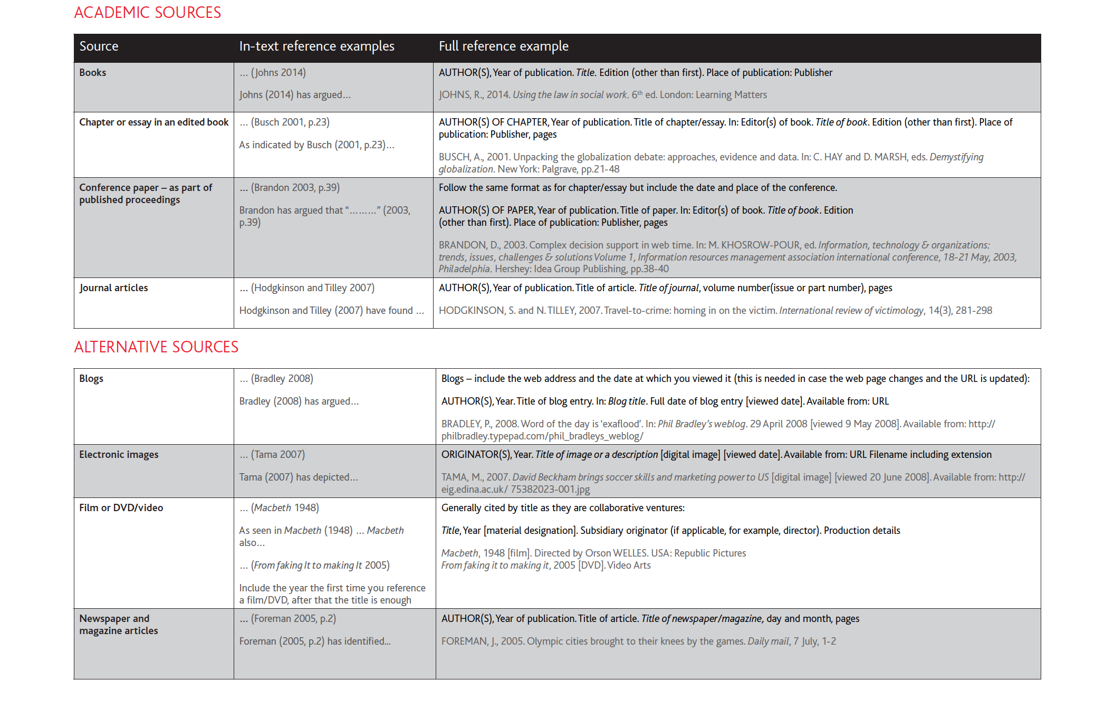

Slide 73
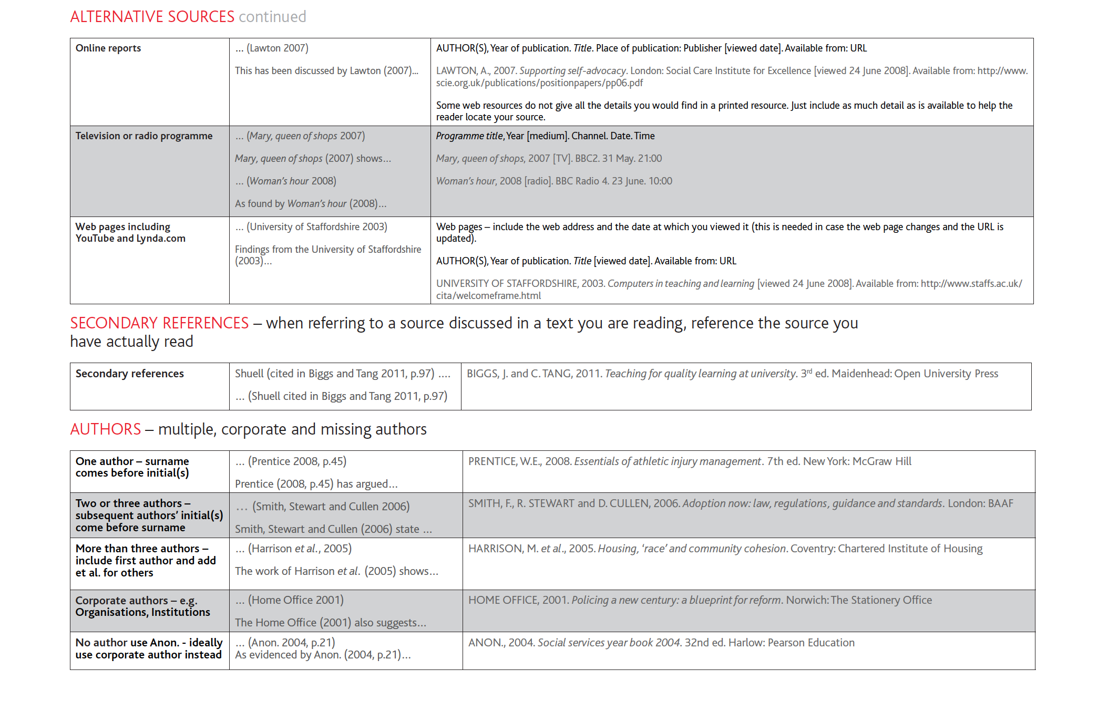

Slide 74
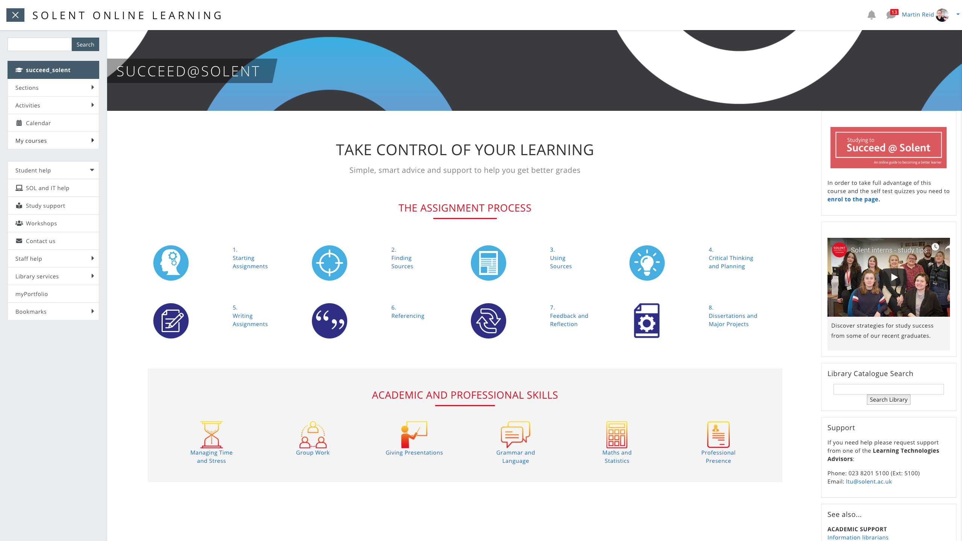
https://learn.solent.ac.uk/course/view.php?id=90

Slide 75
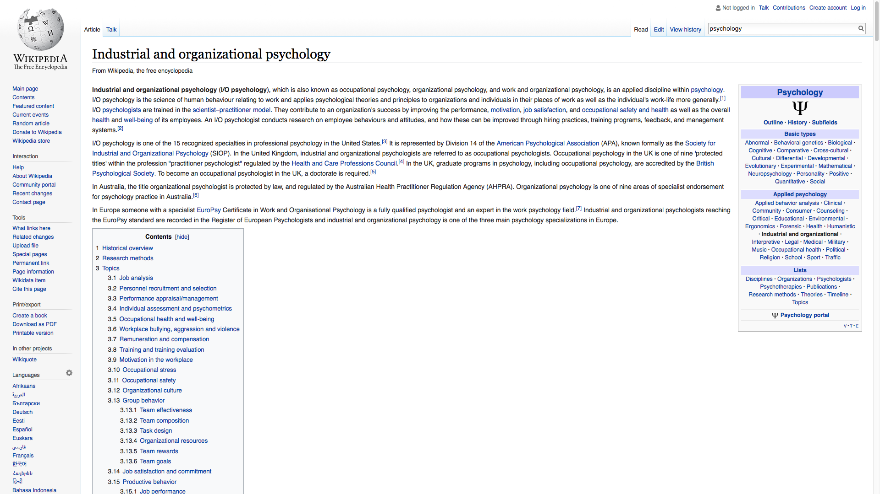
Notes:
Do not reference to wikipedia
https://en.wikipedia.org/wiki/Industrial_and_organizational_psychology

Slide 76
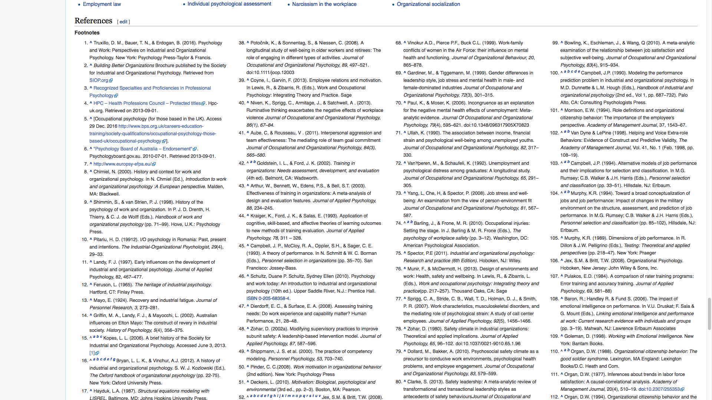
Notes:
But use the references to find original sources and references to them
https://en.wikipedia.org/wiki/Industrial_and_organizational_psychology

Slide 77
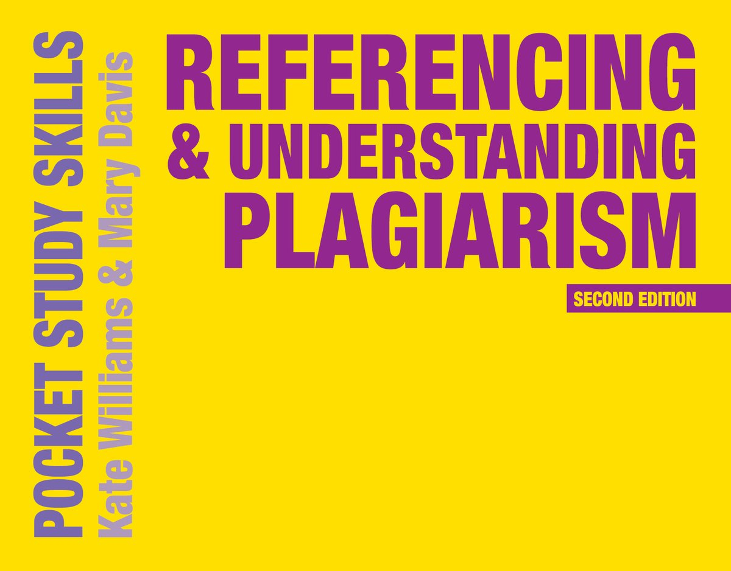
WILLIAMS, K. and M. DAVIS, 2017. Referencing & understanding plagiarism. London: Macmillan Education Available in Mountbatten Library: https://catalogue.solent.ac.uk/discovery/fulldisplay?docid=alma9997011846704796&context=L&vid=44SSU_INST:VU1&search_scope=MyInstitution&tab=Combined&lang=en

